Slide 1


A Tourism App
Notes:
To use this title animation slide with a new image simply 1) move the top semi-transparent shape to the side, 2) delete placeholder image, 3) click on the picture icon to add a new picture, 4) Move semi-transparent shape back to original position, 5) Update text on slide.

Slide 2
Join us & Connect with Culture
Swing is the way
Notes:
To use this title animation slide with a new image simply 1) move the top semi-transparent shape to the side, 2) delete placeholder image, 3) click on the picture icon to add a new picture, 4) Move semi-transparent shape back to original position, 5) Update text on slide.

Slide 3

“India is a country that is known worldwide for its diverse culture and natural beauty.”

Slide 4

Swing
Here we start the Journey

Slide 5
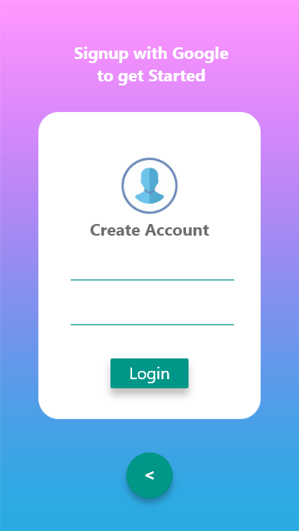
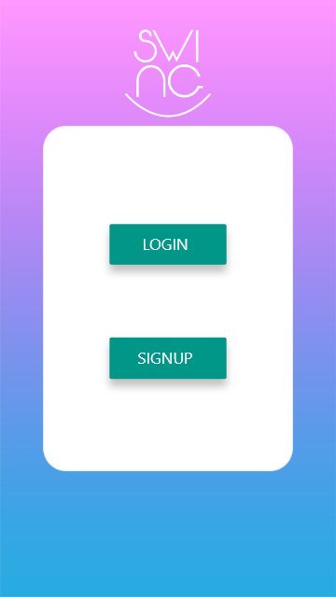
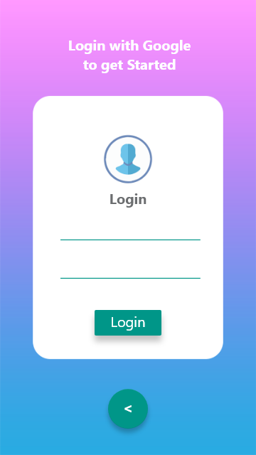
Swing
Get into the Swing
Sign up/Sign in with Google to get Start

Slide 6
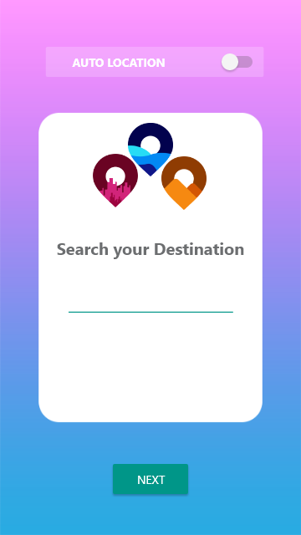

Find Where are You?

Slide 7
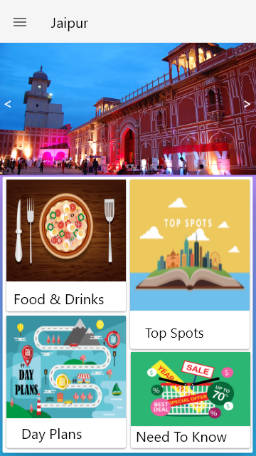
1
Nearby Updates of Events
Food & Beverage information
2
Best Places to visit
Historical Places and their History

Slide 8
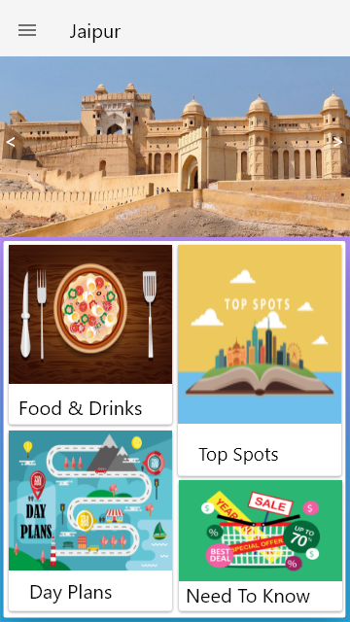
3
Plan you whole day or even Weekends
4
Everything to need to know

Slide 9
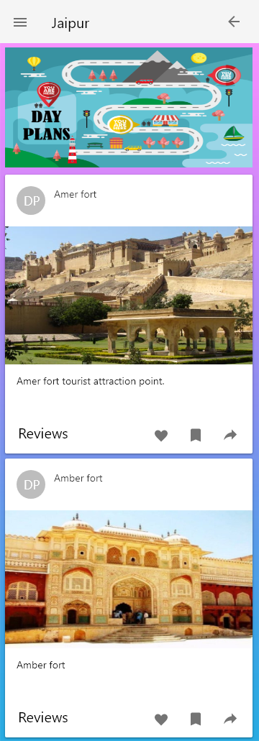
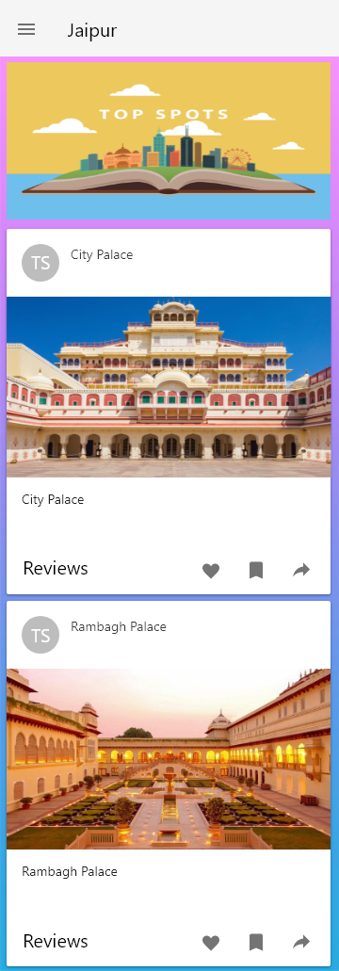
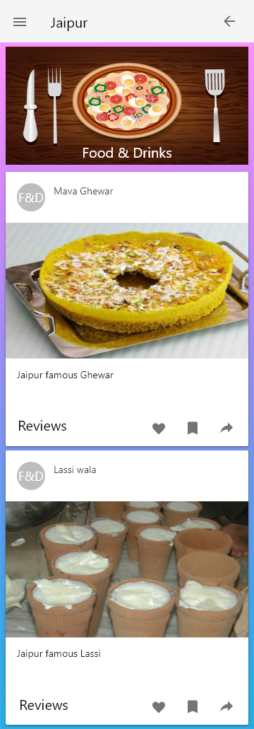
Everything on your Finger tips
Scroll down to learn more.

Slide 10
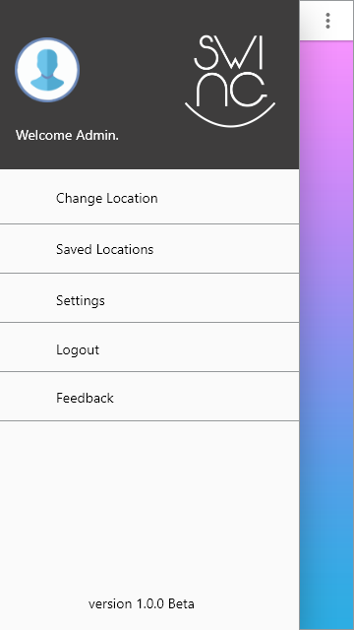
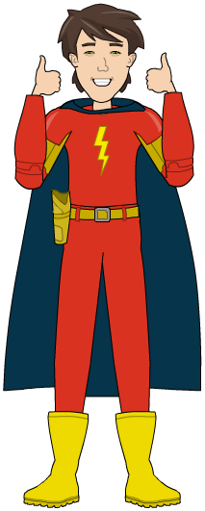
Full of Exciting Features

Slide 11
Thank You
Notes:
To use this title animation slide with a new image simply 1) move the top semi-transparent shape to the side, 2) delete placeholder image, 3) click on the picture icon to add a new picture, 4) Move semi-transparent shape back to original position, 5) Update text on slide.

